Slide 1
Phishing awareness training presentation

Slide 2
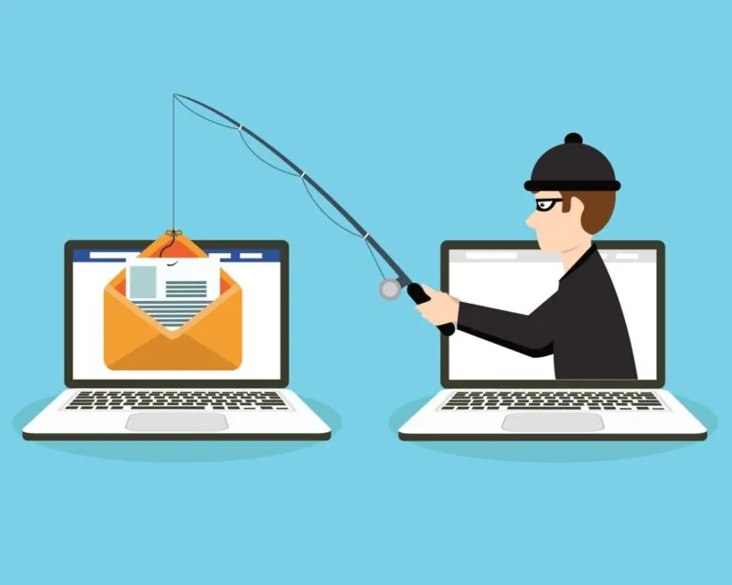
Introduction to phishing
Phishing is a cyber attack where attackers trick individuals into revealing sensitive information like passwords or credit card numbers by pretending to be trustworthy entities (e.g., banks, companies, or government agencies).

Slide 3
:Recognizing Phishing Emails and Fake Websites
Common Signs of Phishing Emails:
Suspicious sender addresses (e.g., support@bank-secure-login.com)
Generic greetings like “Dear Customer”
Urgent or threatening language
Unexpected attachments or links
Misspellings or bad grammar

Slide 4
Social Engineering Tactics
Definition: Manipulating people into giving up confidential info.
Tactics Used:
Impersonation (pretending to be your boss, IT support, etc.)
Creating a sense of urgency (“Your account will be locked!”)
Pretexting (creating a fake story to steal information)
Baiting (offering something tempting, like a free prize or USB drive)

Slide 5
Best practices and tips
Tips to Stay Safe:
Never click links or download attachments from unknown sources
Verify suspicious emails by contacting the sender directly
Use multi-factor authentication (MFA) whenever possible
Regularly update passwords and avoid password reuse
Use anti-virus software and browser security features

Slide 6
Real world examples
Example 1: Google Docs Phishing Scam (fake invitation to view a document, led to credential theft)
Example 2: COVID-19 Relief Scam (emails pretending to offer financial help, but stealing info)
Example 3: CEO Fraud (fake emails from "CEO" asking to wire money)

Slide 7
Summary and final tips
Stay alert and think before clicking.
If in doubt, report the email to your IT/security team.
Cybersecurity is everyone's responsibility!

